Slide 1
Images from
To Kill a Mockingbird

Slide 2
Popular music from 1932
https://playback.fm/year/1932

Slide 3
Chapter 1 vocabulary
Taciturn (adjective)- describes someone who stays silent or avoids joining conversations
Imprudent (adjective)- not wise/careful about making decisions

Slide 4
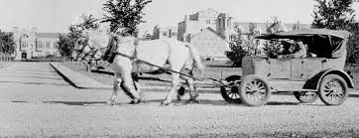
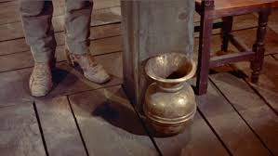
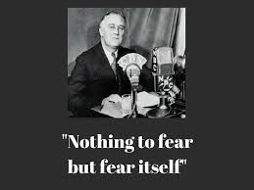
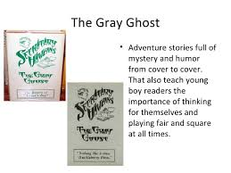
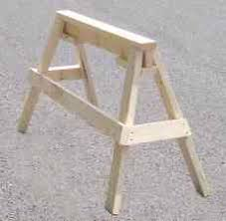
Chapter 1

Slide 5
Intro to Characterization
We judge people based on…
What they look like
What they do
What they say
What we hear others say about them

Slide 6
Intro to Characterization
Here’s what you know about “Amy”
She is wearing a cancer awareness shirt.
You see her in the hall helping a new student find his way to class.
You hear Amy say she understands it’s hard to be a new kid and she’s happy to help.
Later in the week, you see Amy on announcements; she’s won student of the week.
What might you infer about the kind of person Amy is?

Slide 7
Characterization Notes page 31
Our ideas about a character are formed by:
What the character looks like
What the character says
What the character does
What the narrator or others say about the character

Slide 8
Chapter 2 vocabulary
Uninitiated- adj.-not yet introduced into the knowledge or group
Sojourn- noun- a temporary stay
Mortification-noun- a feeling of humiliation/shame

Slide 9
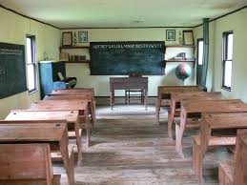
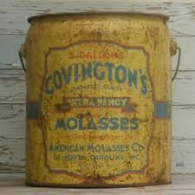
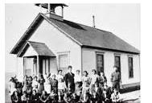
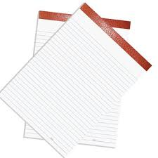
Chapter 2

Slide 10
Chapter 3 vocabulary
Sever-verb- to separate or cut apart from the whole
Irked-adjective- irritated or annoyed
Iniquities-noun- great injustices, wickedness
Expounding-verb- to explain with a lot of detail
Dispensation-noun- a doing away with
Contentious-adjective- quarrelsome; causing or involving
argument/controversy
Concede-verb- to acknowledge as true or fair
Amiable-adjective- pleasant, friendly, agreeable

Slide 11
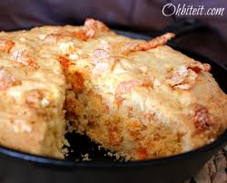
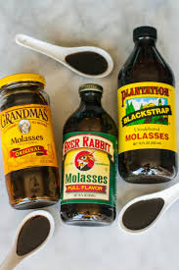
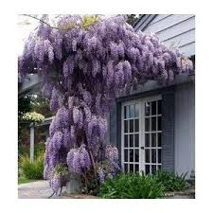
Chapter 3

Slide 12
Chapter 4 vocabulary
Evasion- noun- the act of escaping or avoiding something
Auspicious-adj- favorable, promising success

Slide 13
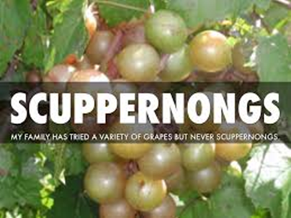
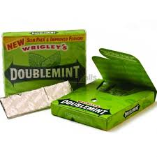
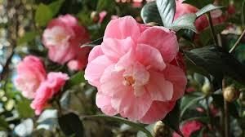
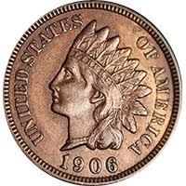
Chapter 4

Slide 14
Chapter 5 vocabulary
Inquisitive-adj-describes a person who asks questions, is eager for
knowledge, or is intellectually curious
Asinine-adj- foolish, stupid, silly, unintelligent
Aloof-adj- at a distance, especially in feeling or interest

Slide 15
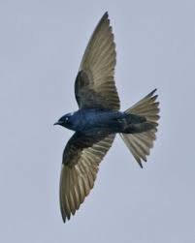
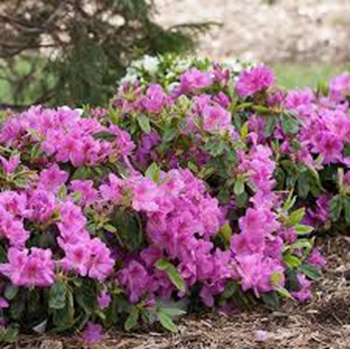
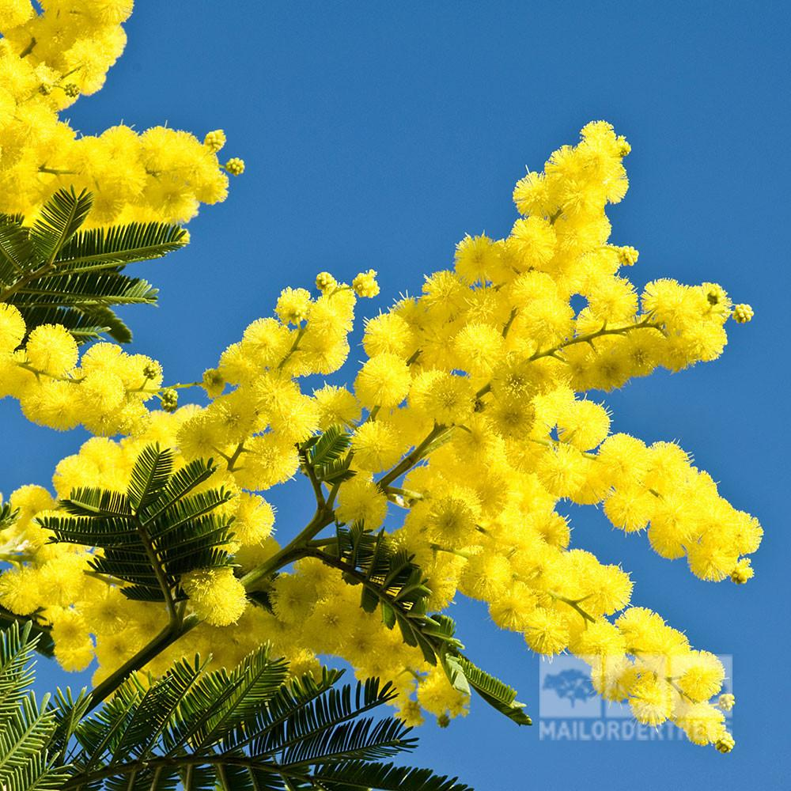
Chapter 5

Slide 16
R.A.C.E. response for chapter 5
Based on what you learn about her in chapter 5 of To Kill a Mockingbird, what word would you use to describe Miss Maudie Atkinson? Use the R.A.C.E. format to write a complete literary analysis paragraph to answer the question. Include a direct quote and a page number.

Slide 17
Chapter 6 vocabulary
Malignant-adj- dangerous or harmful

Slide 18
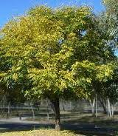
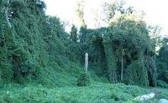
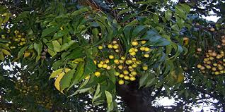
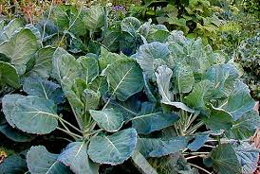
Chapter 6

Slide 19
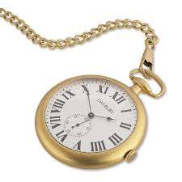
Chapter 7

Slide 20
Chapter 8 vocabulary
Libel-noun- injury of a good reputation by written words, pictures,
or any form other than spoken words
Abberation-noun- the act of going away from the right, normal, or
usual course
Accost-verb- to boldly confront someone

Slide 21
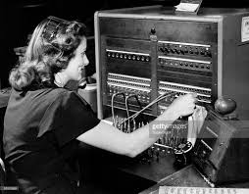
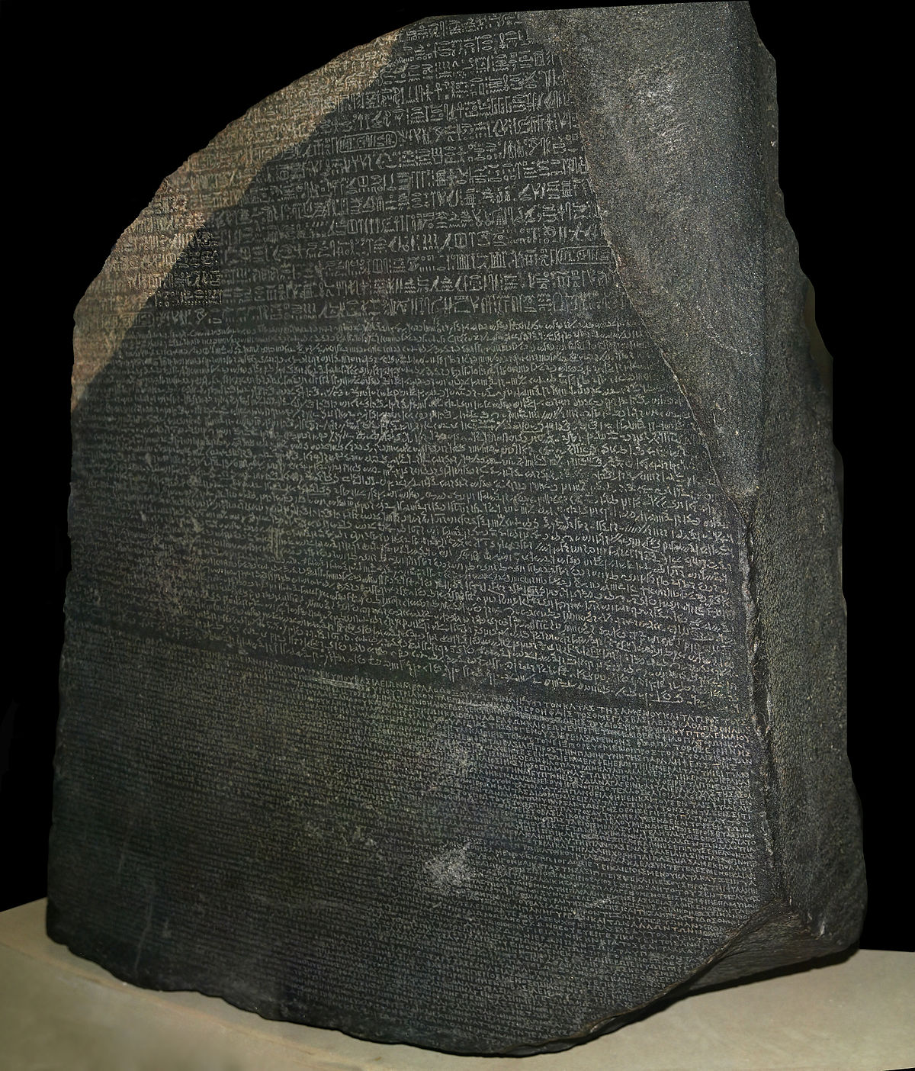
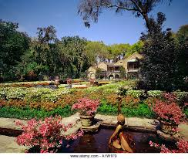
Chapter 8

Slide 22
Chapter 9 vocabulary
Guilelessness- noun- without deception; sincere, honest,
straightforward
Provocation- noun- something that provokes, angers, irritates
Inevitable- adj./noun- unable to be avoided/ something that is
unavoidable
Obstreperous-adj- unruly, noisy, resisting control

Slide 23
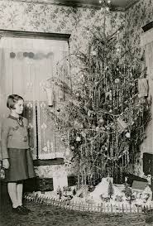
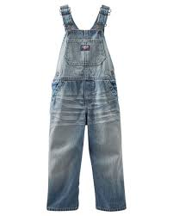
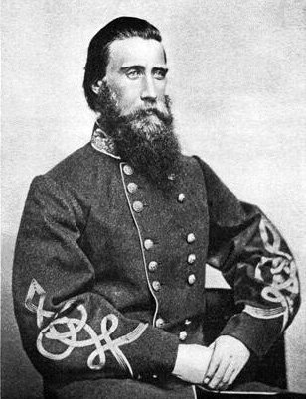
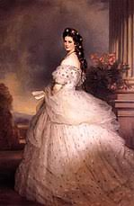
Chapter 9

Slide 24
Chapter 9 R.A.C.E. response
We learn a lot about Atticus on pages 99-102. Choose a word to describe Atticus based on what he says on these pages at the start of chapter 9. Choose 2 pieces of evidence to support your answer and make sure to explain both.
Example format for your paragraph
Restate and answer
Cite and Explain
Cite and Explain

Slide 25
Chapter 10 vocabulary
Rudiment-noun- first principles of a subject, “the basics”
Inconspicuous-adj- NOT clearly visible/attracting attention

Slide 26
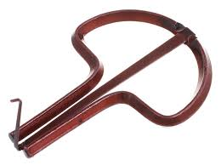
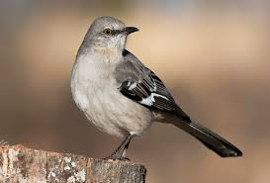
Chapter 10

Slide 27
Chapter 11 vocabulary
Passe- adj- out-dated, out-of-style
Umbrage- noun- offense, annoyance, displeasure
Contemporaries- noun- people of the same age
Propensities- noun- natural inclinations or tendencies

Slide 28
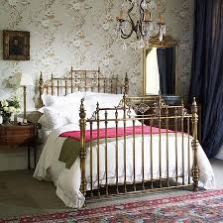

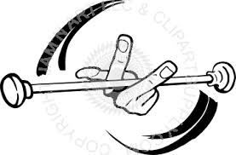
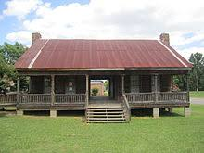
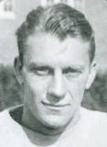
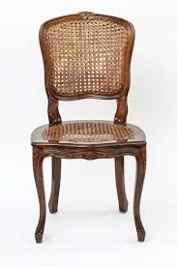
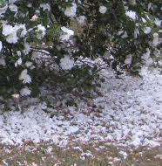
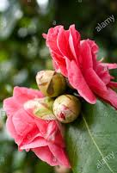
Chapter 11

Slide 29
Chapter 11 R.A.C.E. response
What is an important life lesson or piece of wisdom from chapter 11? Use a specific quote to pinpoint the lesson and explain why it’s important.

Slide 30
Chapter 12 vocabulary
Altercation-noun-a heated or angry dispute; noisy argument or
controversy.
Denunciation-noun- an unfavorable judgement made openly or in
public
Austere-adjective- severe in manner or appearance, strict

Slide 31
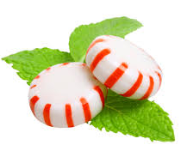
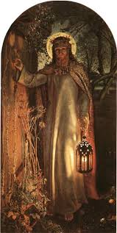

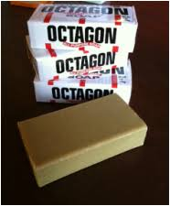
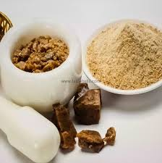
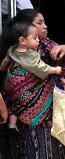
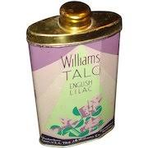
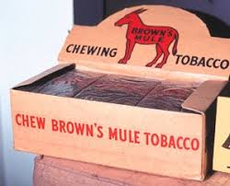
Chapter 12

Slide 32
Reflecting on chapter 12
The events that the narrator chooses to share with us can seem pointless and random sometimes. But the author would never include details that she didn’t think were necessary to some aspect of the story. Complete a RACE response explaining what you think the purpose of chapter 12 is to the novel. Make sure to cite a specific quote that you think illustrates an important aspect of the chapter.
Complete this on a sheet of paper to turn in.
You have 10 mins to complete this assignment.

Slide 33
Chapter 13 vocabulary
Tactful-adj- having a strong sense of what is appropriate to say or do
Prerogative-noun- exclusive right/privilege granted because of rank,
office, etc.
Incurable-adj- not curable, unable to be corrected

Slide 34

Chapter 14

Slide 35
Chapter 15 vocabulary
Venerable-adj- commanding respect because of great age or
impressive dignity
Futility-noun- ineffectiveness, uselessness
Begrudge-verb- to envy or resent the pleasure or good fortune of
someone
Acquiescence-noun- agreement or consent by silence, or without
objection

Slide 36
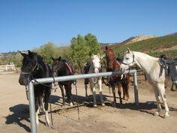
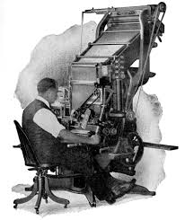
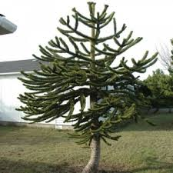


Chapter 15

Slide 37
Chapter 16 vocabulary
Unobtrusive-adj- not sticking out, not easily seen
Elucidate-verb- to make clear

Slide 38
Chapter 17 vocabulary
Indigenous-adj- originating in a particular region/country
Fluctuation-noun- a continual change from one condition to another
Acrimonious-adj- stinging or bitter in nature/speech/behavior/etc.

Slide 39


Chapter 17

Slide 40
Chapter 18 vocabulary
Mollified-adj- softened in feeling or temper, pacified
Lavations-noun- washings
Exodus-noun- a departure of a large group of people

Slide 41
Chapter 20 vocabulary
Iota-noun- a very little bit
Indicted-adj- charged with a crime
Caliber-noun- ability level, quality
Acquit-verb- to declare not guilty

Slide 42
Chapter 21 vocabulary
Indignant-adj- feeling of strong displeasure towards something that’s
considered offensive/unfair

Slide 43
Chapter 22 vocabulary
Feral-adj- wild, not domesticated
Cynical-adj- distrustful/pessimistic about other people’s motives

Slide 44
Chapter 23
Sordid-adj- of low moral quality; dirty
Obscure-adj- not clear, vague, uncertain
Furtive-adj- taken/done/used secretly, sly
Credibility-noun- believability

Slide 45
Chapter 24 vocabulary
Impertinence-noun- rudeness or disrespect
Brevity-noun- shortness of time or duration

